Slide 1
Waytop Microspheres
Expandable Microspheres in Explosives
Technical Guide
www.expandablemicrosphere.com

Slide 2
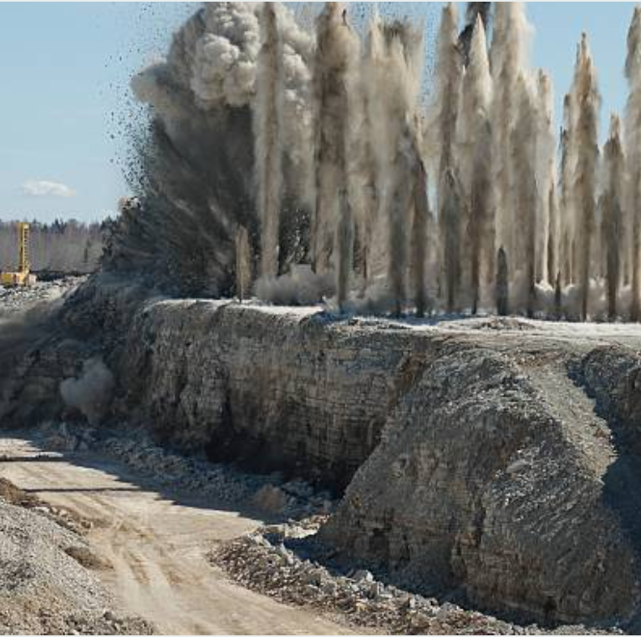
Subjects
Waytop Microspheres
Introduction of Expandable Microspheres
Expandable Microspheres in Explosives
Benefits in Explosives
Microspheres Grades to Choose
Mixing Processing
Comparison with Glass Spheres
www.expandablemicrosphere.com

Slide 3
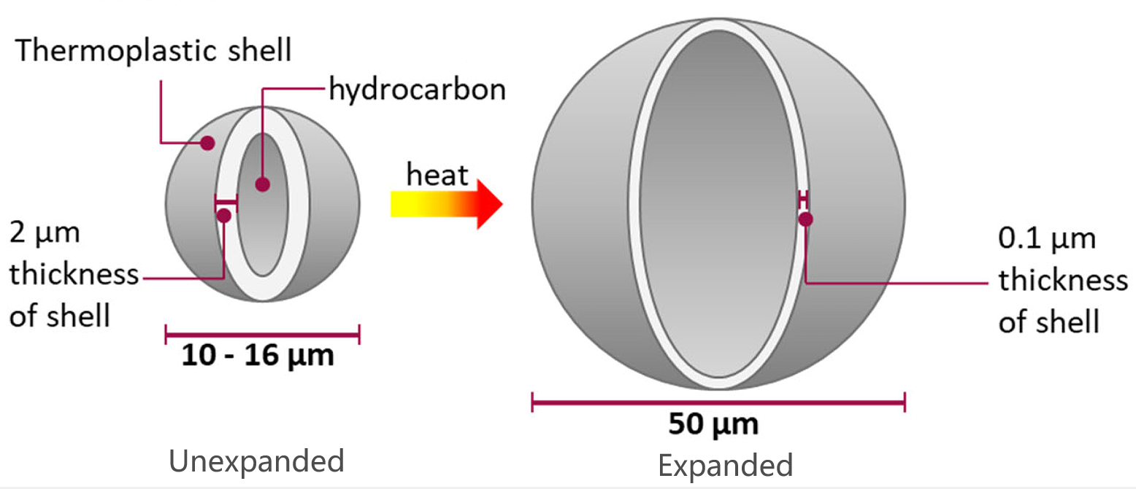
Introduction of Expandable Microspheres
Waytop Microspheres
Two forms of products: Unexpanded and Expanded.
Extremely low density, 20kg/m3;
Free-flowing white powder, hollow spheres;
Thermoplastic polymer shell and hydrocarbon gas inside;
www.expandablemicrosphere.com

Slide 4
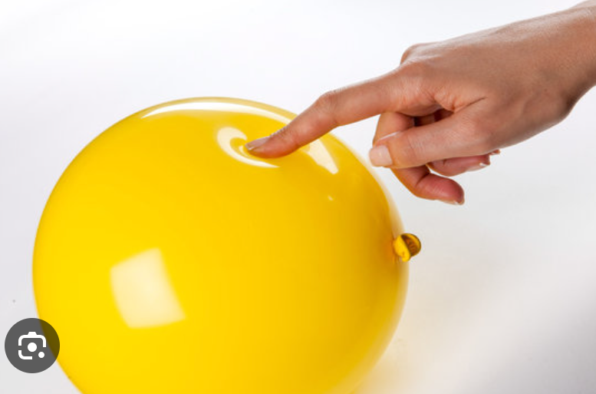
Introduction of Expandable Microspheres
Waytop Microspheres
Compressibility
Expanded microspheres show spherical shape when it is under atmospheric pressure.
Expanded microspheres will be compressed under high pressure, for example 5 bar.
Expanded microspheres will be back to original spherical shape when pressure is released.
The resilience will prevent the microspheres from breaking during filling into explosives cartridges.
www.expandablemicrosphere.com

Slide 5
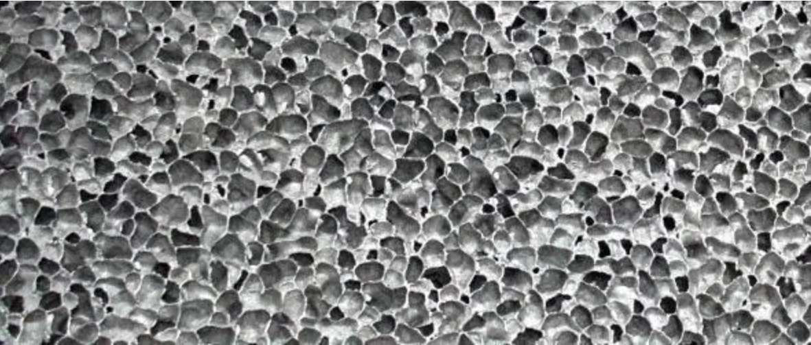
Introduction of Expandable Microspheres
Waytop Microspheres
Closed-Cell Structure
Expandable microspheres has the uniform and controlled closed cell structure.
Extremely Low Density
To get the same density reduction, expanded microspheres will take much less dosage compared to the glass bead, saving you much on total cost.
www.expandablemicrosphere.com

Slide 6
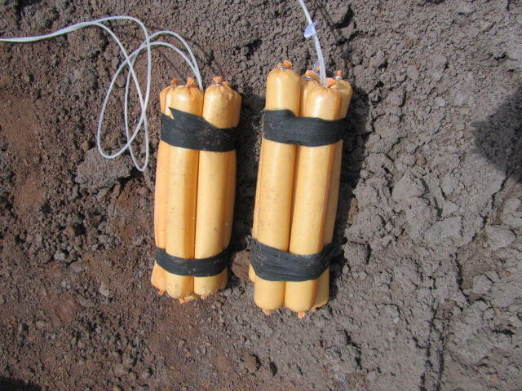
Different Civil Explosives
Waytop Microspheres
Mainly 4 kinds of civil explosives:
Emulsions
Nitroglycerine dynamites
Dry blasting agents (ANFO mainly)
Water-based slurry gels
Expandable microspheres is mainly used in emulsion explosives, but also in ANFO prills and cartridges, which is applied as sensitizer as its stable closed-cell structure and thermal plastic shell.
www.expandablemicrosphere.com

Slide 7
Benefits Applying Microspheres on Emulsion Explosives
Waytop Microspheres
Increase VOD
The velocity of detonation will be increased when microspheres are added, this is very important in some blasting applications.
Lower Density
0.5 % dosage of expanded microspheres will decrease the density of emulsion explosive from 1400kg/m3 to 1150kg/m3, which is very important to get the better performance of explosives properties, 5 to 10 times less than the addition of glass microspheres.
Storage stability
Expanded Microspheres could withstand 95°C for more than 3 hours in the mixture of emulsion explosives. No problems is found.
Improve Compressibility
Expanded microspheres could withstand high pressure processing in the emulsion explosive, without any breakage.
Increase Combustion
The expanded microspheres can improve the combustion of emulsion explosives since it is an organic material and like a fuel during detonation.
www.expandablemicrosphere.com

Slide 8
Waytop Microspheres
Expanded Microspheres Grades to Choose
We recommend dry expanded grades for explosion application:
Grade | Average Particle Size (μm) | Softening Temp (℃) | Density kg/m3
WP20D | 20-30 | 110±5 | 30-40
WP40D | 30-50 | 100±5 | 20-30
WP80D | 70-90 | 120±5 | 15-25
WP100D | 90-110 | 85±5 | 13-18
www.expandablemicrosphere.com

Slide 9
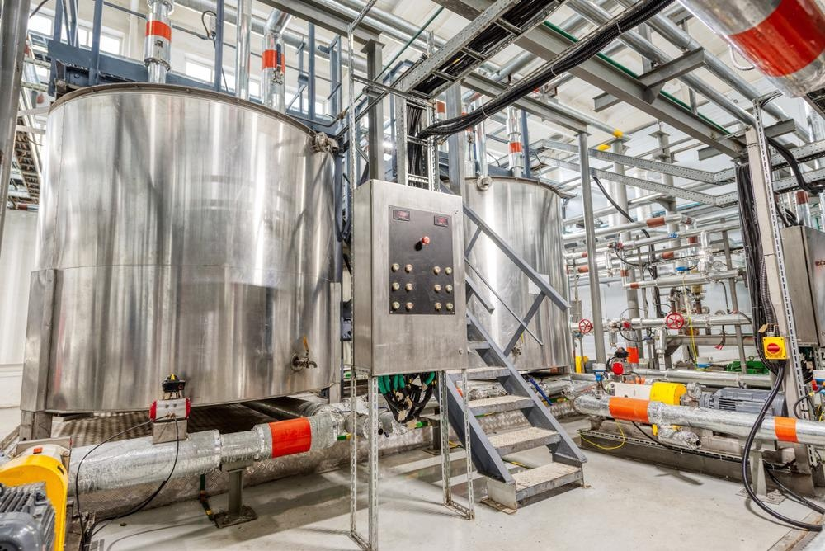
The Mixing Operation
Waytop Microspheres
Dosage: 0.4-0.6% of expanded microspheres;
Dosing expanded microspheres directly into the emulsion matrix mixing equipment;
Common equipment with higher mixing speed can be used in the mixing of the emulsion matrix to get faster and proper dispersion, since the expanded microspheres have good compressibility, without any spheres are destroyed. But the glass spheres will have a high proportion being destroyed during the mixing step.
www.expandablemicrosphere.com

Slide 10
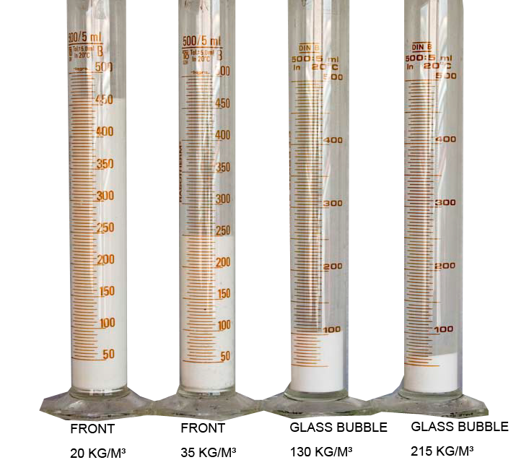
Comparison with Glass Spheres
Waytop Microspheres
Density/Volume: Expanded microspheres has 5-10 times bigger volume than the glass spheres;
Compressibility: Expanded microspheres has good compressibility and could withstand high shear force without any breakage of spheres. The glass spheres is rigid shell and need to disperse in slow stirring, or the spheres will break easily and lose the volume.
Cost Saving: expanded microspheres has low cost in final product than the glass spheres to get the same density reduction.
Waytop
Waytop
www.expandablemicrosphere.com

Slide 11
Waytop Microspheres
Thank You！
If you want to learn more, please contact us.
www.expandablemicrosphere.com

